Slide 1

Nutri-Scope AI V2: Detailed Workflow and System Architecture
Revolutionizing Health Insights from Lab Reports
Developed by Venkata Sai Krishna Aditya Vatturi

Slide 2

Project Overview
The Problem
Our Solution
Traditional lab reports are complex, filled with medical jargon, and difficult for patients to understand. Critical health insights remain buried in confusing data.
NutriScopeAI V2 transforms PDF lab reports into clear, actionable health insights using advanced AI analysis and personalized nutritional guidance.
Key Goal
Empower users with personalized, easy-to-understand health information that drives better wellness decisions and outcomes.

Slide 3
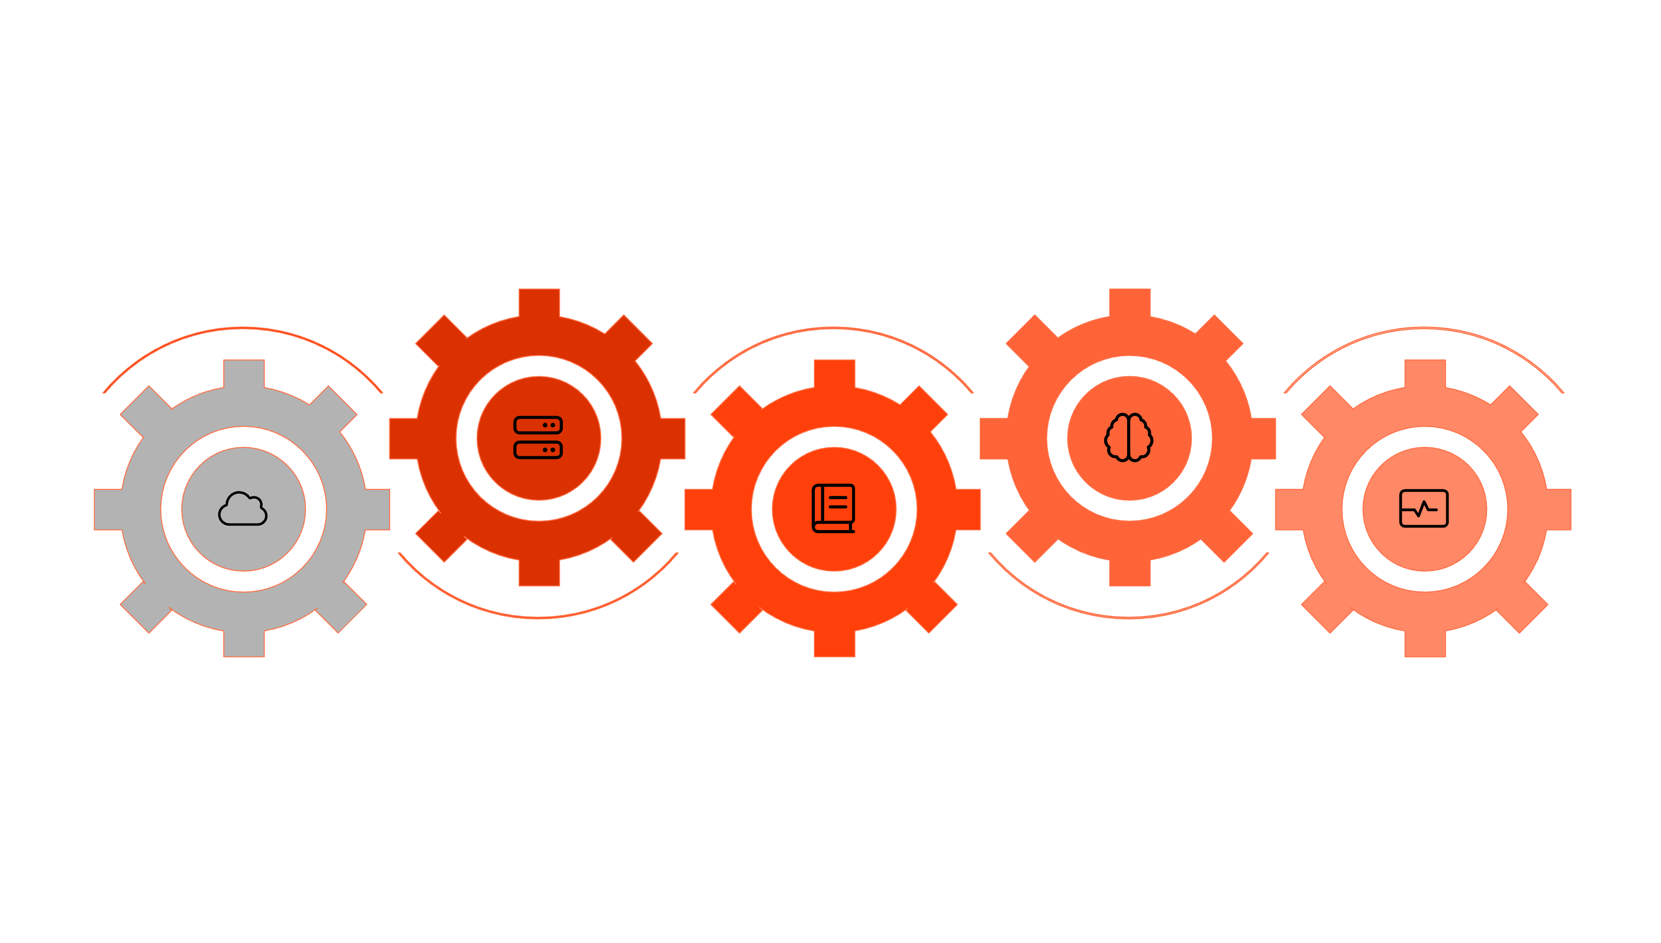





The End-to-End Workflow
Backend Processing
AI Summarization
Ingest, parse, normalize, analyze
Generate concise, patient-focused summary
User Upload
Knowledge Base
Report Display
Upload PDF and metadata securely
Evaluate against stored medical data
Present results and downloadable report
User Upload
Backend Processing
Report Display
Users securely upload lab report PDFs along with personal metadata through our intuitive interface.
Our API orchestrates data ingestion, parsing, normalization, knowledge base evaluation, and AI-powered analysis.
Users receive personalized, actionable health insights with clear summaries and meal recommendations.

Slide 4
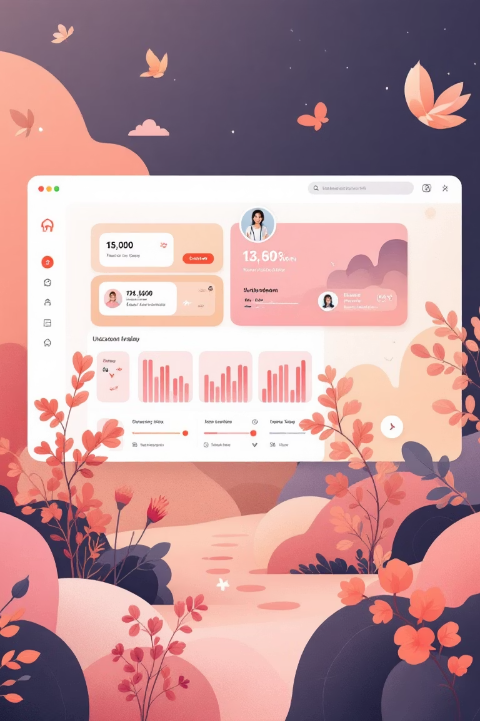
Frontend Interaction
01
02
File Upload Interface
Secure API Communication
The frontend/pages/upload.py module provides a seamless drag-and-drop interface for PDF uploads and metadata collection, ensuring user-friendly data submission.
The frontend/pages/utils.py module handles authenticated API requests with robust error handling and real-time processing status updates.
03
Dynamic Report Display
The frontend/pages/report_details.py component renders interactive summary tables and personalized meal plan cards with clear visual hierarchy.

Slide 5

Backend API and Data Ingestion
Central API Hub
Intelligent Data Extraction
The backend/app/api/routes.py serves as the orchestration layer, managing the entire analysis pipeline with robust error handling and logging.
The backend/app/ingest/parser.py uses advanced parsing algorithms to extract test names, values, and units from complex PDF structures.
OCR Fallback System
When standard parsing fails, backend/app/ingest/extract.py employs OCR technology to process scanned or low-quality documents reliably.

Slide 6



Data Normalization and Evaluation
Data Standardization
Knowledge Base Integration
The normalization modules clean and standardize extracted data, mapping test names to canonical forms and converting units to consistent standards.
The system cross-references normalized data against comprehensive medical knowledge bases for accurate health assessments.
Test name mapping (e.g., "Hb" → "Hemoglobin")
kb/loader.py loads reference ranges
Unit standardization (mg/dL → mmol/L)
core/evaluator.py flags abnormal values

Slide 7




AI Summarization: The Core Innovation
Powered by Groq LLM API
Intelligent Analysis
Risk Assessment
The backend/app/summarize/llm.py module leverages advanced language models to generate personalized health insights from flagged test results.
AI identifies potential health risks, explains abnormal values, and provides context about long-term implications if conditions remain untreated.
Personalized Nutrition
Generates tailored meal plans with specific food recommendations designed to address individual health concerns identified in lab results.

Slide 8




Storage and Persistence
Report Generation
The backend/app/storage/reports_store.py module securely saves complete AI-generated reports with comprehensive health insights.
Data Durability
All reports, including original data and AI summaries, are stored in structured JSON format in backend/app/storage/reports.json for reliable retrieval.
Security & Privacy
Healthcare data is encrypted and stored with enterprise-grade security measures, ensuring HIPAA compliance and user privacy protection.

Slide 9


Summary & Future Vision
1
Current Achievement
NutriScopeAI V2 delivers a comprehensive, end-to-end solution that transforms complex lab reports into personalized, actionable health insights.
2
Technical Foundation
Built on robust architecture combining frontend UX, backend APIs, intelligent parsing, AI summarization, and secure data management.
3
Future Expansion
Roadmap includes historical data tracking, wearable device integration, advanced dietary recommendations, and expanded health monitoring capabilities.
Ready to revolutionize how patients understand and act on their health data

